Slide 1



Lecture Series: Statistics for Biologists Lecture 3, 12-09-2016
Gopal Karemore, PhD
Novo Nordisk Center for Protein Research (Protein Imaging Platform)
&
Danish Stem Cell Center
Organizer:
Claudia Lukas
Anne Grapin-Botton
Jutta Maria Bulkescher

Slide 2

Course topics : (0.8 ECTS-eight hours)

Slide 3

Generating Hypothesis (lecture 2…)
Null Hypothesis (H0)
Experimental = Control
or
Experimental – Control = 0
Science is all about Falsification and
not confirmation
e.g.
Coffee
smoking
Pancreatic
cancer
Alternative Hypothesis (HA)
Experimental != Control
or
Experimental – Control != 0
Notes:
Science is all about Falsification and confirmation. Its a series of conjucture and refutation.

Slide 4
Errors in hypothesis testing (Lecture 2…)
Observed conclusion
 | Accept H0 No observed difference | Reject H0 Observed difference
H0 (true) No difference | Correct decision (True Negative) | Type I error (False Positive)
H0 (false) Difference | Type II error (False Negative) | Correct decision (True Positive)
Unknown truth
Probability of making Type I error
Level of Significance
Probability of making Type II error
(1-B) is the power of the test

Slide 5
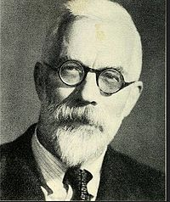
p-value
The p-value is defined as the probability of obtaining a result equal to or "more extreme" than what was actually observed, when the null hypothesis is true.
(https://en.wikipedia.org/wiki/P-value)
The p-value, or calculated probability, is the probability of finding the observed, or more extreme, results when the null hypothesis (H₀) of a study question is true – the definition of 'extreme' depends on how the hypothesis is being tested.
www.statsdirect.co.uk
The p-value is the probability of obtaining the value of the
test statistics (or one more extreme) just by chance alone
when Null hypothesis is true.
Prof. Marie Diener-West http://www.jhsph.edu/
Sir Ronald A Fisher
introduced P values in the
1920s
The greatest biologist
since Darwin

Slide 6
Test Statistics
(sample statistics – hypothesized value)
Test statistics =
Standard error of the sample statistics
e.g. In case of Difference between Independent sample means (two sample)
Sample statistics = observed difference between sample means
Standard error of the sample statistics = standard error of difference between the means
hypothesized value = 0 i.e. No difference between means

Slide 7
Test Statistics Types
Parametric Tests or Standard Test of hypotheses
Depends on certain assumption of parent population from which we draw samples. e.g. normal population, large sample size etc.
Z-test, t-test, x²-test (Chi-square test), F-test
Non-parametric tests or distribution-free test of hypotheses
Does not depend on any assumption about parameters of the parent population
Wilcoxon mann whitney test, Kruskal–Wallis test
<
Test Statistics
<
Test Statistics

Slide 8
Why can’t we always use non-parametric tests?
NPT need more samples (n) to achieve same Type 1 and Type 2 errors as that of PT
You compromise with the Power of your test
It is not intuitive as parametric
In some cases the population may not be normally distributed, yet tests will be applicable on account of the fact that we mostly deal with samples and sampling distributions closely approach normal distribution.
Recent Techniques: Bootstrapping, Robust parametric tests
Notes:
More reading : Is It Really Robust?
Reinvestigating the Robustness of ANOVA Against Violations of the Normal Distribution Assumption
Emanuel Schmider et al., Methodology (2015), 6, pp. 147-151.

Slide 9

*Which test statistics to be used
Question 1 : Purpose of your Hypothesis
Question 2 : Nature of your sample
Difference of Means
Difference of
Variance
Association between Categorical data
Difference of
Medians
One or
Two groups
More than
Two groups
F-test
Two groups
More than
Two groups
Chi-square
test
Fisher's exact
test
Large Sample Size
Small Sample Size
(Lecture 4)
Z-test
t-test
ANOVA
Wilcoxon-Mann-Whitney
test
Kruskal Wallis test
Paired
unpaired

Slide 10
Difference of Means (two sample case, u_{1,} u₂)
Case 1
σ₁
σ₁
Case 2
σ₂
σ₂
Case 3
σ₃
σ₃
Mean 1 (u₁)
Mean 2 (u₂)
σ₁ < σ₂ < σ₃
Analysis of Variance (σ²)

Slide 11
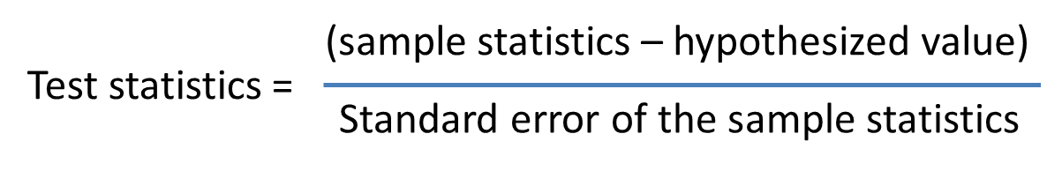
Hypothesis testing of Means
Hypothesis Question (plain english):
Patients on Drug (readout): [20 12 15 18 24]; u₁=17.8, σ₁ = 4.6
Patients on Placebo (readout): [23 19 18 20 26]; u₂=21.2, σ₂ = 3.3
Hypothesis Question:
H0: u1 – u2 = 0
Ha₁: u1 – u2 !=0 (two tail)
Ha₂: u1 – u2 > 0 (one tail)
Conditions:
Z-test:
Population normal or infinite
Sample size large or small
Variance of population known
t-test:
Population normal or infinite
Sample size Small
Variance of population unknown

Slide 12

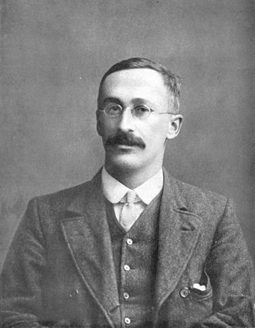
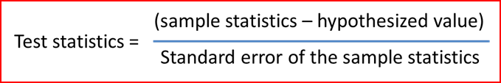
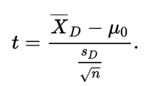
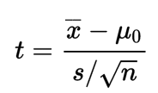
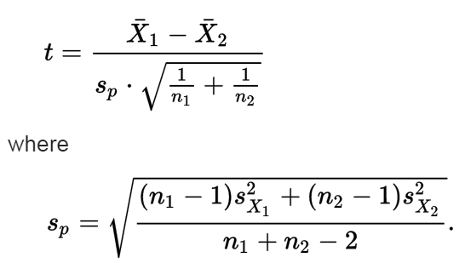
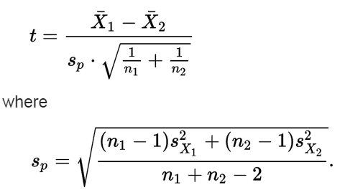
Student's t-test
William Sealy Gosset
Independent two-sample t-test
Dependent t-test for paired samples
One-sample t-test
Equal sample sizes,
equal variance
Equal or unequal sample sizes,
equal variance
H₀
Critical region
Unequal Variance
Welch's t-test
t > tc : reject H₀
t < tc : accept H₀
t_{c}
t_{c}

Slide 13
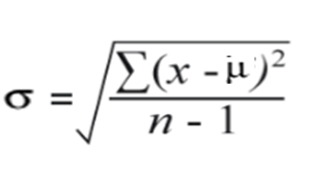
Degrees of Freedom (d.f.)
A = 20
B = 25
C= 30
Average=25
n = 3
A – Average = -5
B - Average = 0
C – Average = ?
Average=25
n = 3
This has to be +5 if the sum needs to be zero
(A – Average) + (B – Average) + (C – Average) = 0
This can take
any value
This can take
any value
This can not
take any value
This is fixed
degrees of freedom = n-1 = 3-1 = 2
Conservative

Slide 14
Examples (one sample t-test )
A one sample t-test allows us to test whether a sample mean (of a normally distributed variable) significantly differs from a hypothesized value.
Patients on Drug (readout): [20 12 15 18 24];
We think average drug readout H₀ = 0; let’s test our hypothesis
[H,P,CI,STATS] = ttest([20 12 15 18 24],H₀)
H =
1
STATS =
tstat: 8.6444
df: 4
sd: 4.6043
CI =
12.0829 23.5171
P =
9.8496e-04
Reject null
hypothesis
at 5% significance level
[H,P,CI,STATS] = ttest([20 12 15 18 24],17.8)
H =
0
STATS =
tstat: 0
df: 4
sd: 4.6043
CI =
12.0829 23.5171
P =
1
Fail to reject null
hypothesis
at 5% significance level

Slide 15
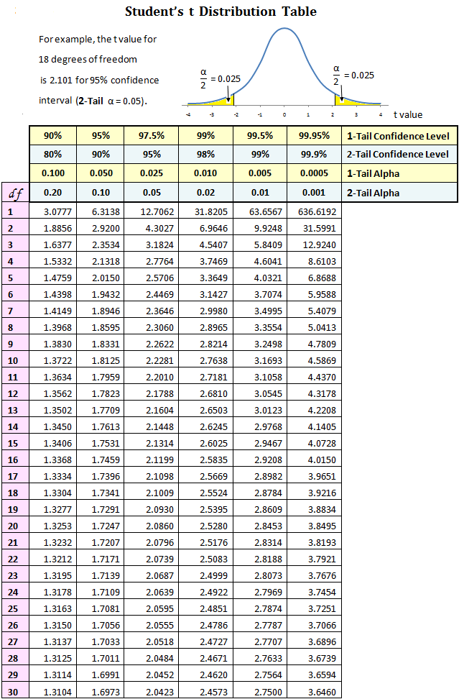

Slide 16
Critical region
P-value
- 2.77
2.77
8.6444
Probability of getting 8.644 or more extream is nothing but the p-value of t-test
The p-value is the probability of obtaining the value of the test statistics that you obtained
(or one more extreme) just by chance alone when Null hypothesis is true.

Slide 17
Examples (two sample t-test )
ttest2(X,Y) Performs a t-test of the hypothesis that two independent samples, in the vectors X and Y, come from distributions with equal means
Patients on Drug (readout): [20 12 15 18 24]; u₁=17.8, σ₁ = 4.6
Patients on Placebo (readout): [23 19 18 20 26]; u₂=21.2, σ₂ = 3.3
H₀= u1-u2 = 0 = Null Hypothesis
[H,P,CI,STATS] = ttest2([20 12 15 18 24],[23 19 18 20 26])
H =
0
STATS =
tstat: -1.3461
df: 8
sd: 3.9937
CI =
-9.2247 2.4247
P =
0.2152
Fail to Reject null
hypothesis
at 5% significance level

Slide 18
Effect of Alpha on two sample t-test
[H,P,CI,STATS] = ttest2([20 12 15 18 24],[23 19 18 20 26],’alpha’,0.05)
STATS =
tstat: -1.3461
df: 8
sd: 3.9937
CI =
-9.2247 2.4247
P =
0.2152
Fail to Reject null
hypothesis
at 5% significance level
(95% confidence)
H =
0
[H,P,CI,STATS] = ttest2([20 12 15 18 24],[23 19 18 20 26],’alpha’,0.01)
STATS =
tstat: -1.3461
df: 8
sd: 3.9937
CI =
-11.8753 5.0753
P =
0.2152
Fail to Reject null
hypothesis
at 1% significance level
(99% confidence)
H =
0

Slide 19
Effect of tail (one/two) on t-test
Group A
Group B
[H,P,CI,STATS] = ttest2([20 12 15 18 24],[120 112 115 118 124],'tail',both')
STATS =
tstat: -34.3401
df: 8
sd: 4.6043
CI =
-106.7152 -93.2848
P =
5.6524e-10
Reject null
hypothesis
at 5% significance level
(95% confidence)
H =
1
There is a difference between Group A and Group B
[H,P,CI,STATS] = ttest2([20 12 15 18 24],[120 112 115 118 124],'tail','right')
STATS =
tstat: -34.3401
df: 8
sd: 4.6043
CI =
-105.4151 Inf
P =
1.000
Fail to Reject null
hypothesis
at 5 % significance level
(95 % confidence)
H =
0
[H,P,CI,STATS] = ttest2([20 12 15 18 24],[120 112 115 118 124],'tail','left')
STATS =
tstat: -34.3401
df: 8
sd: 4.6043
CI =
-Inf -94.5849
P =
2.8262e-10
Reject null
hypothesis
at 5 % significance level
(95 % confidence)
H =
1

Slide 20
Paired t-test
Sample | Baseline | Follow-up
1 | 20 | 120
2 | 12 | 132
3 | 15 | 117
4 | 18 | 111
5 | 24 | 20
ttest(X,Y) performs a paired t-test of the hypothesis that two matched samples, in the vectors X and Y, come from distributions with equal means.
[H,P,CI,STATS]=ttest([20 12 15 18 24],[120 132 117 111 20])
STATS =
tstat: -3.7354
df: 4
sd: 49.2057
CI =
-143.2969 -21.1031
P =
0.0202
Reject null
hypothesis
at 5% significance level
(95% confidence)
H =
1

Slide 21
Non-parametric test (difference in medians) Mann-Whitney U test/ Wilcoxon rank sum test
[P,H,STATS]=ranksum([20 12 15 18 24],[120 132 117 111 20])
STATS =
ranksum: 16.5000
CI =
NA NA
P =
0.0238
Reject null
hypothesis
at 5% significance level
(95% confidence)
H =
1
Power Increment
[H,P,CI,STATS] = ttest2([20 12 15 18 24],[120 132 117 111 20])
STATS =
tstat: -4.0305
df: 8
sd: 32.2467
CI =
-129.2300 -35.1700
P =
0.0038
Reject null
hypothesis
at 5% significance level
(95% confidence)
H =
1
There is a difference between Group A and Group B

Slide 22
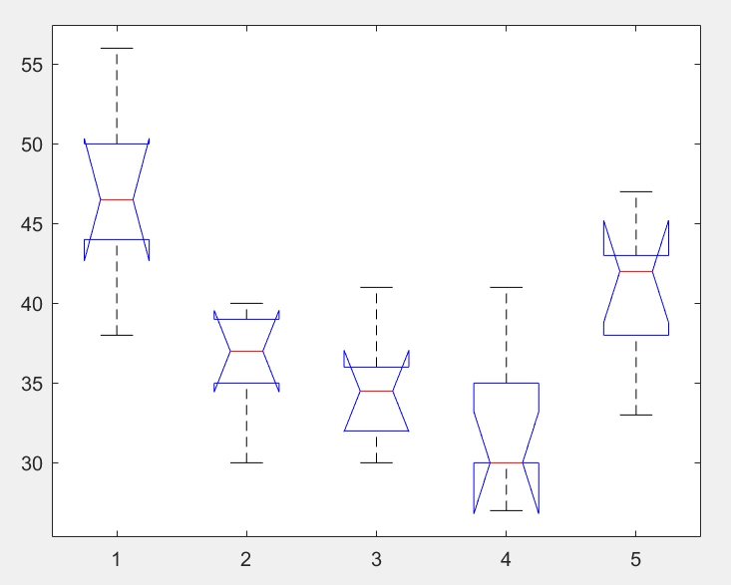
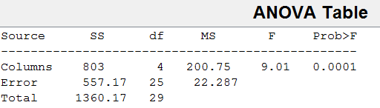
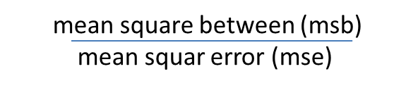
More than two groups: ANOVA (Linear Models..Lecture 5)
Case 1: One- way Analysis of Variance
Purpose: To find out whether data from several groups have a common mean
or
To determine whether the groups are actually different in the measured characteristics
H₀ = all group means are equals
Matlab/SPSS
Example
Box plots
[p,tbl,stats]=anova1(MyData)
Exp1
Exp2
Exp3
Exp4
Exp5
47 37 34 30 42
38 30 32 30 47
44 35 30 27 42
50 40 36 30 38
56 37 35 35 33
46 39 41 41 43
Experiements are not same
Chance of otherwise is
(1 in 10,000)
MyData

Slide 23
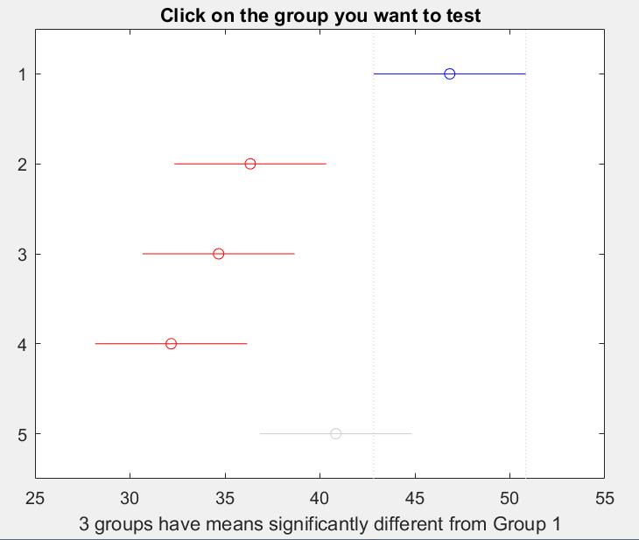
Multiple Comparison or Post hoc analysis (SPSS)
Case 1: One- way Analysis of Variance
Purpose: To find out pairs of means are significantly different
Types: honestly significant differences, least significant difference, tukey-kramer (default), dunn-sidak, bonferroni, scheffe.
Matlab/SPSS
Experiment pair
p-value
tukey-kramer
[p,tbl,stats]=anova1(MyData)
[c,m]=multcompare(stats)
1 2
1 3
1 4
1 5
2 3
2 4
2 5
3 4
3 5
4 5
0.005
0.001
0.000
0.211
0.971
0.554
0.480
0.887
0.190
0.029
Experiements are not same
Chance of otherwise is
(1 in 10,000)

Slide 24
More than two groups: ANOVA (Linear Models)
Case 2: Two- way Analysis of Variance (Factorial Analysis of Variance)
Purpose: To find out whether data from several groups have a common mean with TWO categories of defining characteristics.
H₀ = all group means are equals
Example: Suppose you have 5 groups in your experiment and you have possibility of doing these experiment in 2 different manner (e.g. two replicates or two labs or two concentrations). It will be called 2 x 5 factorial analysis
Interest:
If you would like to know how readout varies from experiments to experiment as well as lab location to lab location independently (for example).→ Main effects/additive effects
Difference in the group of one independant variable vary according to the level of second independant variable → Interaction/ Moderator effects

Slide 25
Understanding Main effects and Interactions
Placebo
Drug_{X}
dx₁
Interaction
(difference of difference)
Is dx₂ >dx₁ ?
Treatment Effect
(Mortality Rate)
dx₂
Baseline (T₀)
Follow-up (T₁)
Years/Hours

Slide 26
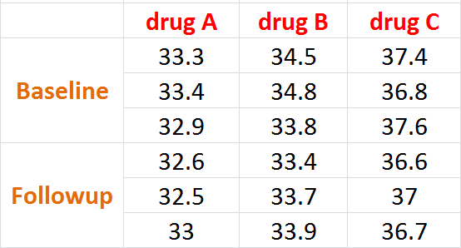
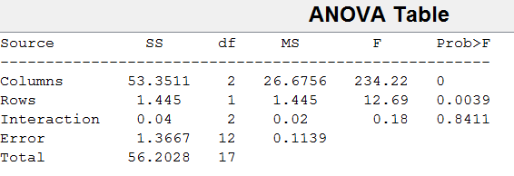
Example : Two-way ANOVA
drug_study
Use F-statistics to do hypotheses to find out if the treatment effect is same across time points, drugs and timepoint-drugs pair
[p,tbl,stats]=anova2(drug_study,3)
Treatement effect varies from one drug to another
Treatement effect varies from baseline to followup
No interaction between time points and drugs on treatment effect

Slide 27
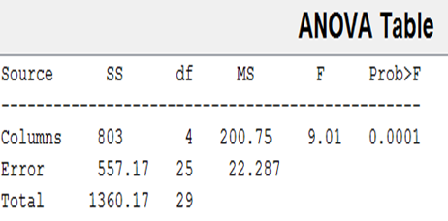
Nonparametric ANOVA
One way ANOVA :- Kruskal-Walis Test
Example
Box plots
[p]=kruskalwalis(MyData)
p = 0.002
Exp1
Exp2
Exp3
Exp4
Exp5
47 37 34 30 42
38 30 32 30 47
44 35 30 27 42
50 40 36 30 38
56 37 35 35 33
46 39 41 41 43
MyData

Slide 28
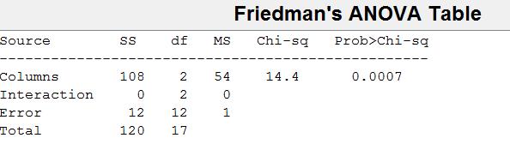
Nonparametric ANOVA
Two way ANOVA :- Friedman’s Test
[p,tbl,stats]=friedman(drug_study,3)
Friedman’s test can’t compute Interactions
[p,tbl,stats]=anova2(drug_study,3)

Slide 29
Thank You!
Normalization methods (HCS)
Chi-square test

